Slide 1
Tuesday
Announcements and Regroup

Slide 2
Where have we been, where are we going?
Monday and Tuesday – 16S and shotgun bioinformatics
Wednesday – 3MT and Statistics
Thursday and Friday – Interpretation and small group analysis

Slide 3
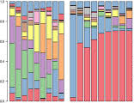

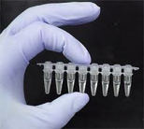
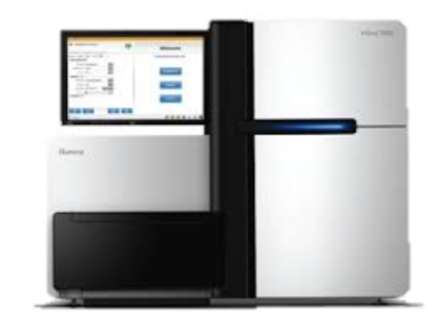
There are differences along this entire workflow except extraction
Extraction
Library Prep
Sequencing
Data Analysis
AGTTCAC
(x 10⁸)

Slide 4
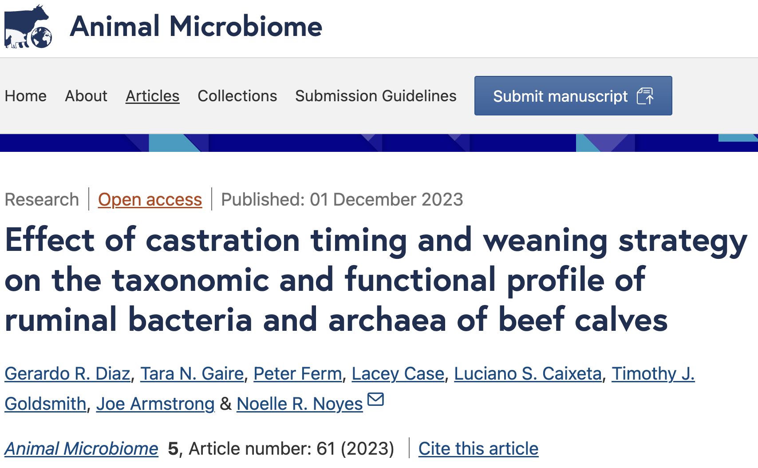
There are differences along this entire workflow except extraction
Extraction
Library Prep
Sequencing
Data Analysis
AGTTCAC
(x 10⁸)
Bioinformatics
Statistics
Visualization
AGTTCAC
(x 10⁸)
Diversity
Abundance
etc….
Interpretation

Slide 5
Questions?

